Slide 1

Mapping Social Vulnerability and Flood Damages Public Housing Units in Lumberton, North Carolina after Hurricane Matthew, 2016
Sayma Khajehei- MCRP
May 6,2019

Slide 2
Abstract
Scholars believe that residents of public housing are one of the most socially vulnerable people that face significant damages in disasters.
Hurricane Matthew made landfall in North Carolina on October 8, 2016, as a Category 1 storm.
Lumberton were devastated by heavy rainfall and the river flooding that began after Hurricane Matthew.
Lumberton is a diverse socio-demographic city with one-third of households who live at or below the poverty level.
Lumberton has a particular combination of minorities with a high percentage of African American and Native American.
This city has 729 public housing units.
The flood destroyed 37% of public housing units in Lumberton.

Slide 3
Data and Maps
Data:
2015-ACS estimation data
U.S. Department of Housing and Urban Development (HUD) data
Housing Authority of City of Lumberton (HACL) data
A part of survey data of my thesis
Maps:
Social vulnerability at the block-group level in Lumberton, NC,
Location of public housing developments in the city,
Damage assessment of public housing units’ samples
Abandoned public housing developments

Slide 4
This Project & My Thesis
My thesis Goals:
Find the specific vulnerabilities of the public housing residents in Lumberton, North Carolina
I use social vulnerability weighted Index defined by Van Zandt and Colleagues in 2012 to show the distribution of vulnerability in the city.
How these vulnerabilities affect the impact of flood damages in the public housing developments.
Show the location of public housing developments and the damages to these units based on damage assessment of the sampled units to show the severity of damages.

Slide 5


My thesis is a part of a larger longitudinal and interdisciplinary recovery-based field study in Lumberton conducted by the Center of Excellence (CoE) on Risk-Based Community Resilience Planning with collaborators from the National Institute of Standards and Technology (NIST).

Slide 6
Web Mapping Technology
Excel
QGIS
GeoJSON
HTML, CSS, JavaScript, and JQuery
Leaflet maps
HighCharts
Array

Slide 7
Key Challenges
Preparing my damage assessment data that I have to reduce the sampled units for this project. I have 596 samples and I need 88 of them for this project.
Making Coropleth maps
Find a way to present all the information on a single map.
Working on the format of the webpage to present maps and charts and the texts

Slide 8
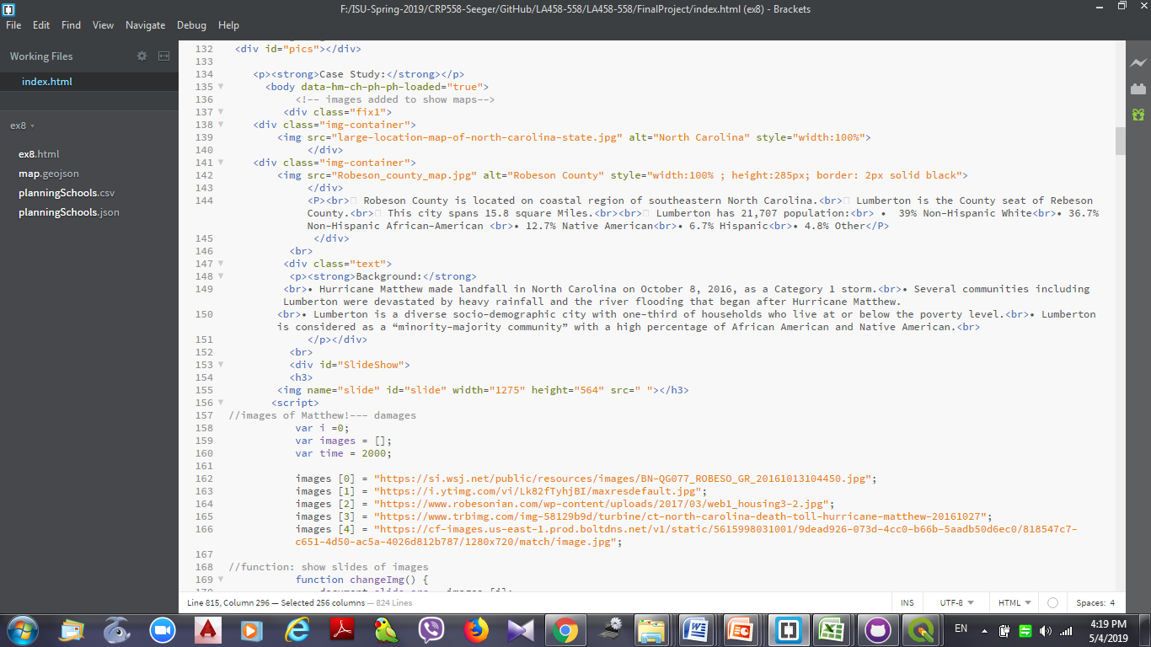
Introduction Part
Using containers to have two images and text together in a line!

Slide 9
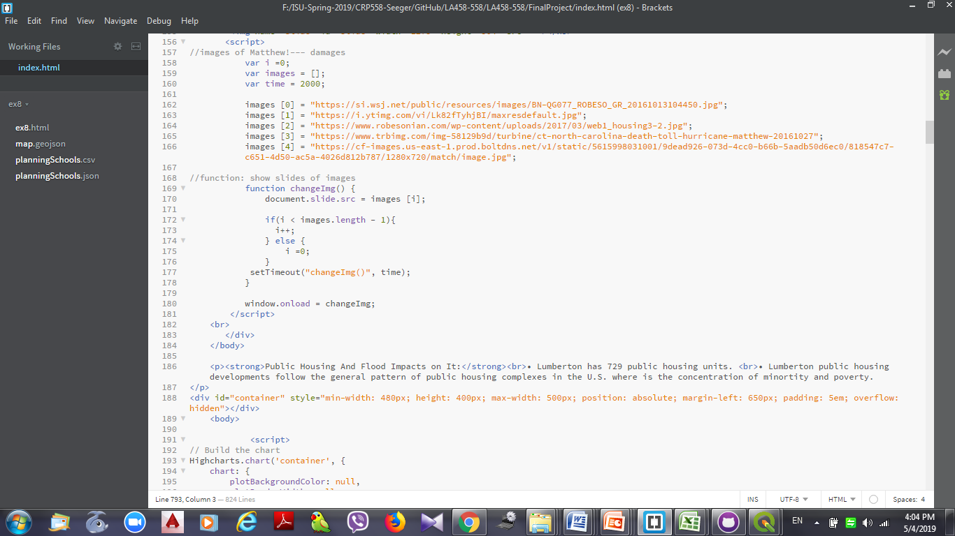
Images Slide Show
Having image slide show to show some pictures of the floods
Using Array

Slide 10
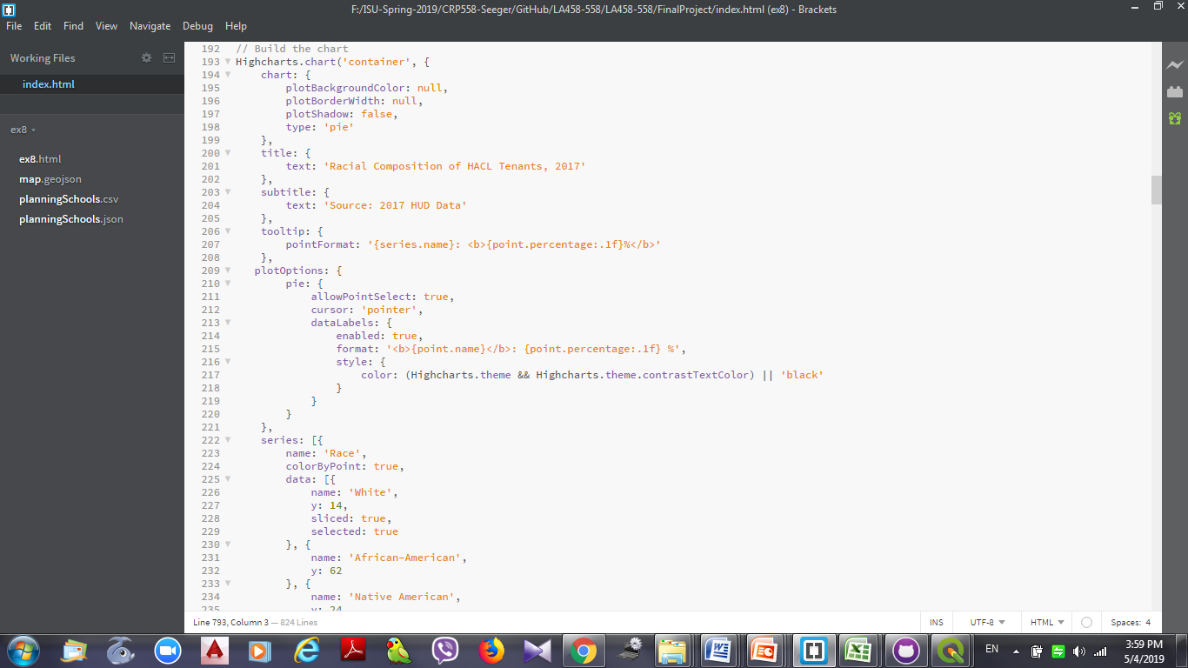
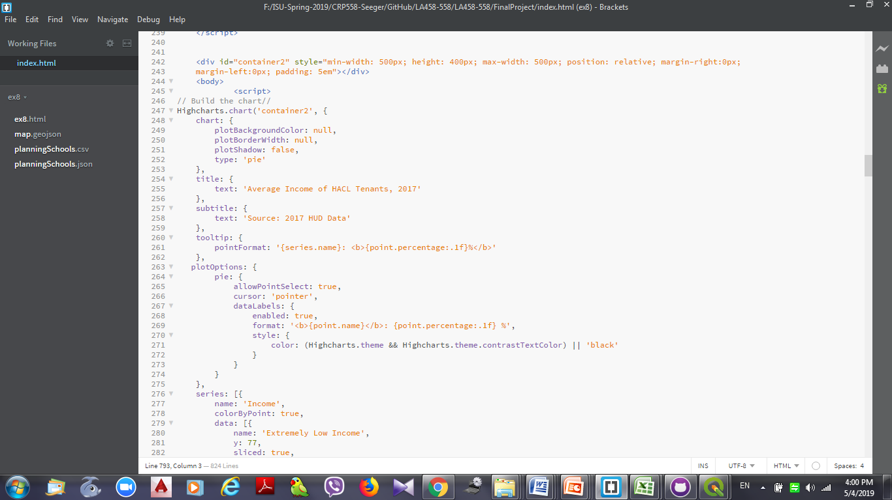
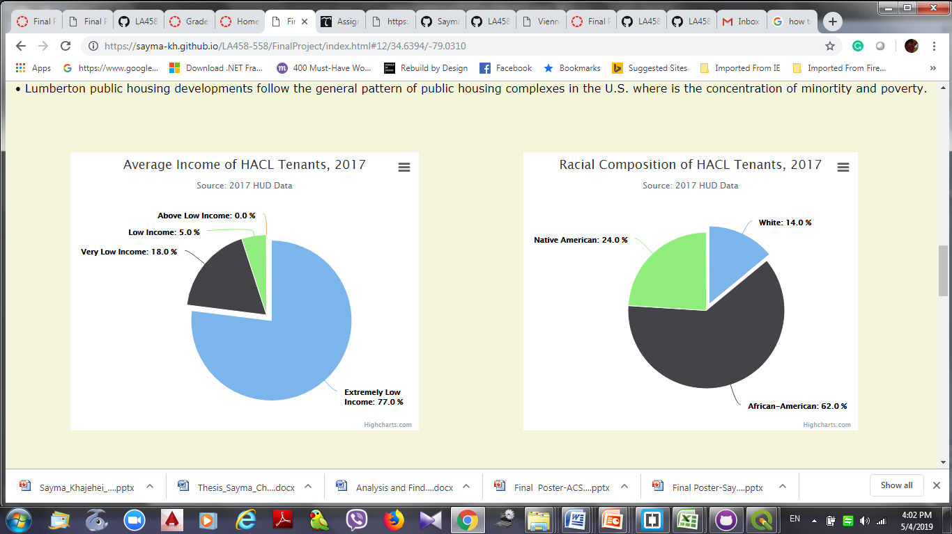
Charts
Using Highchart’s pie chart code
Using containers to have the charts in a line

Slide 11
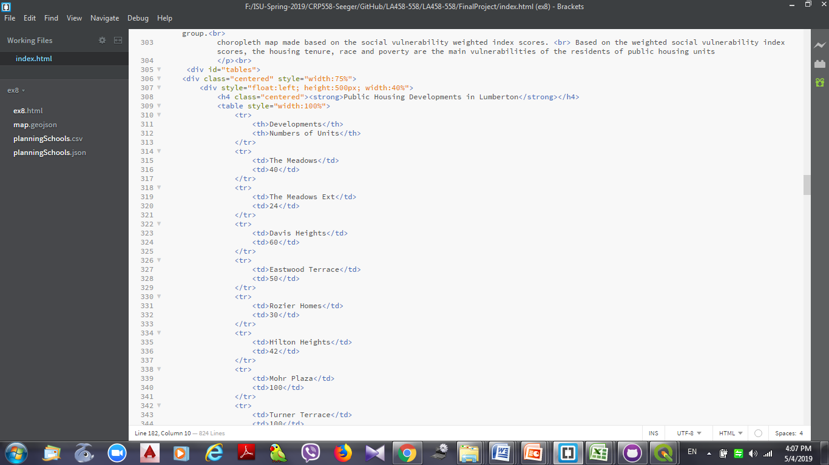
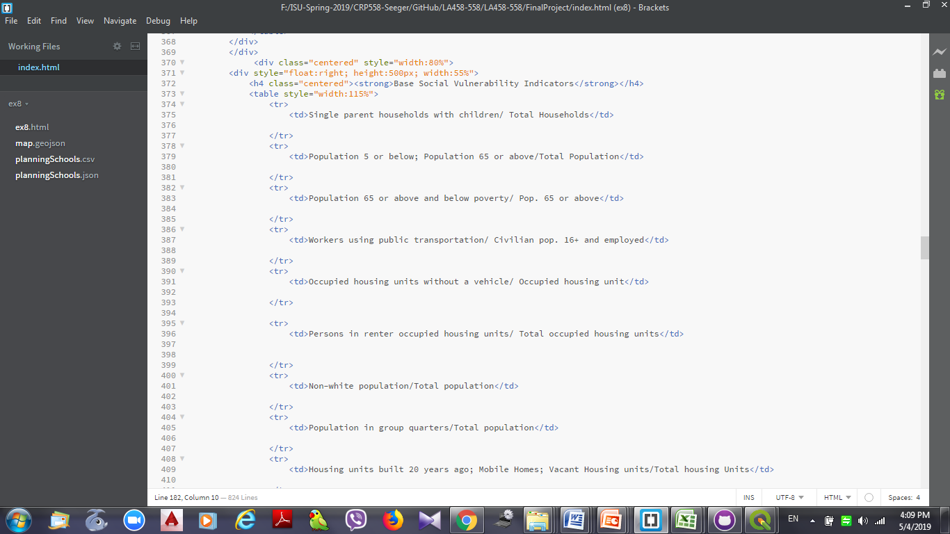
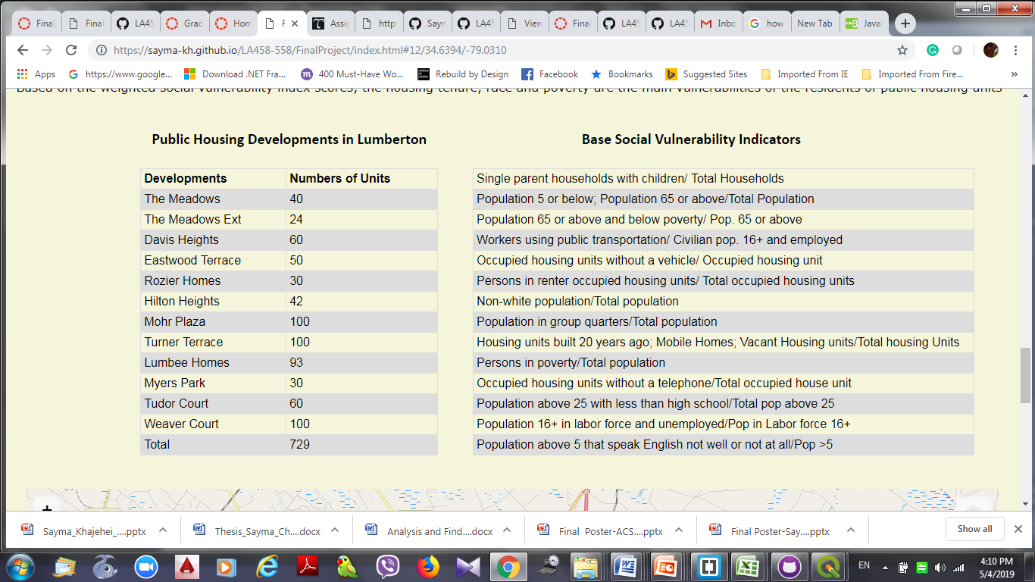
Tables
Using html codes to make tables
Using containers to have the tables in a line

Slide 12
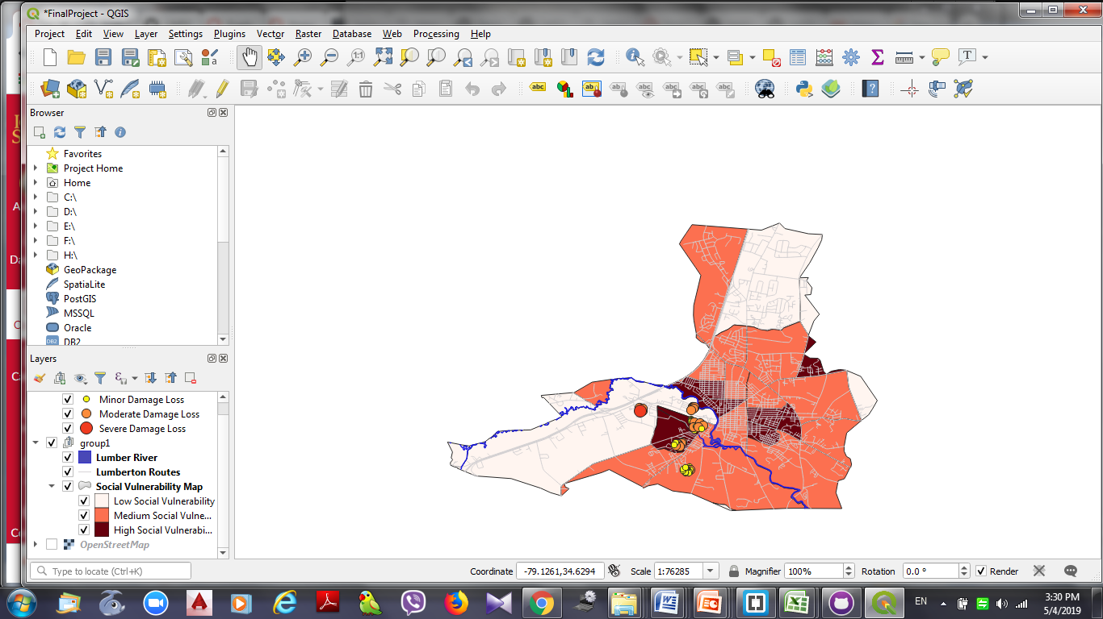
Maps
Joined Excel table to the Block Groups’ in QGIS to make Coropleth map
Export public housing point features and add them to the map
Add layers such as river, roads, and open street map

Slide 13
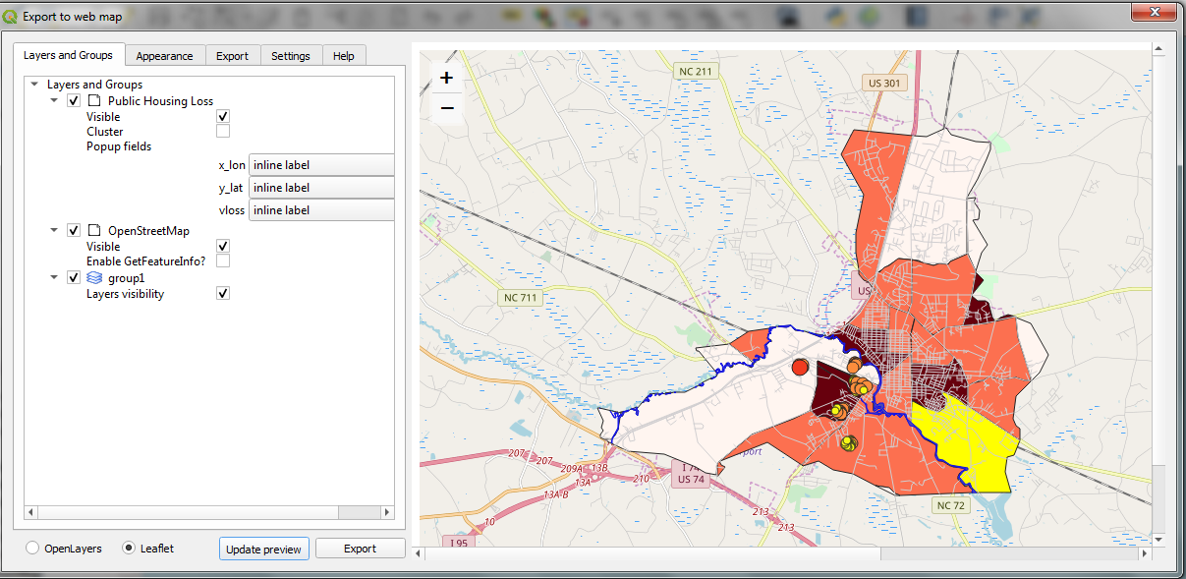
Maps
Exporting the leaflet map in QGIS
Using the code in the html file

Slide 14
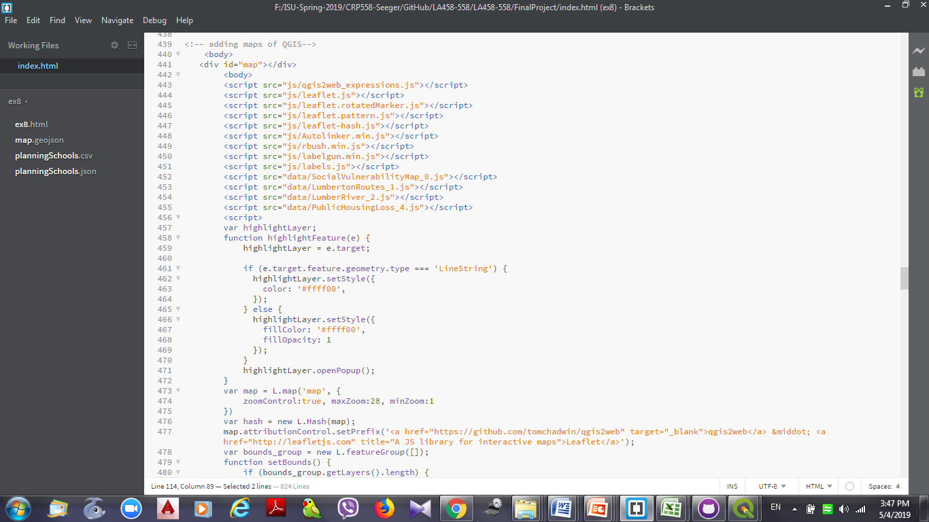

Slide 15
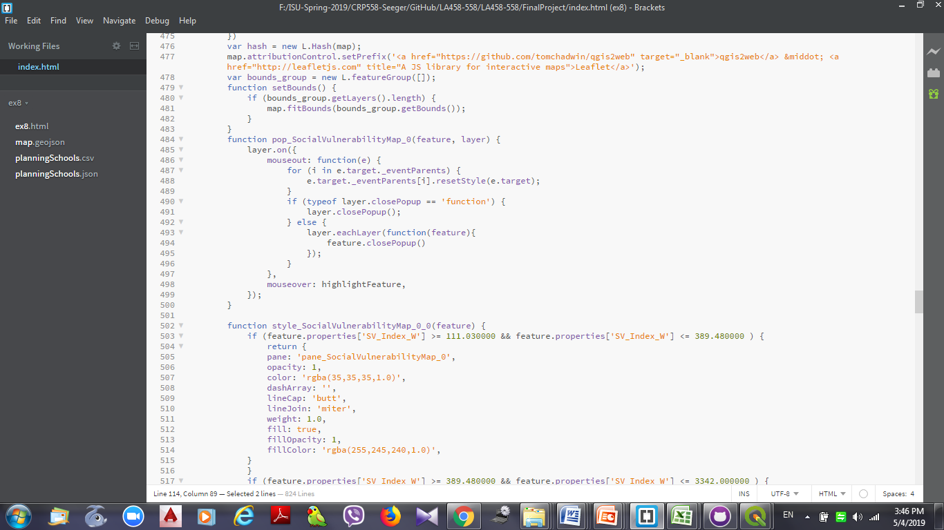
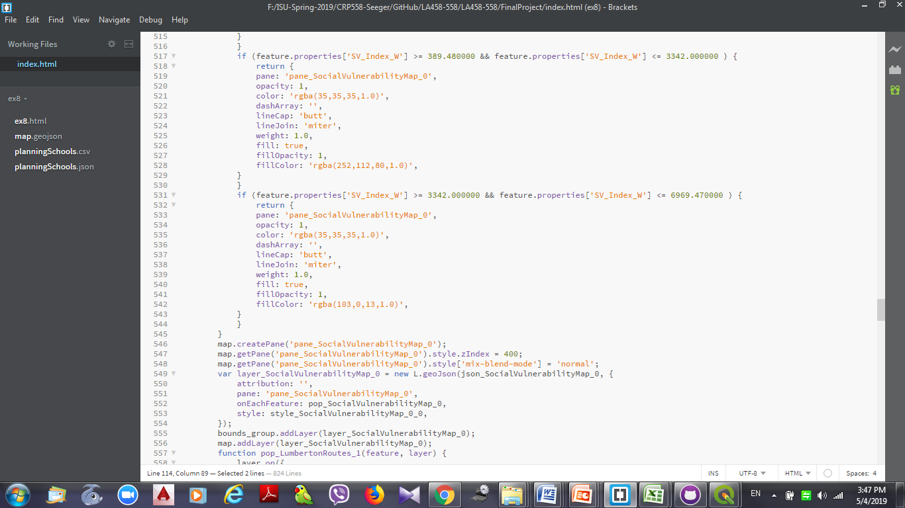
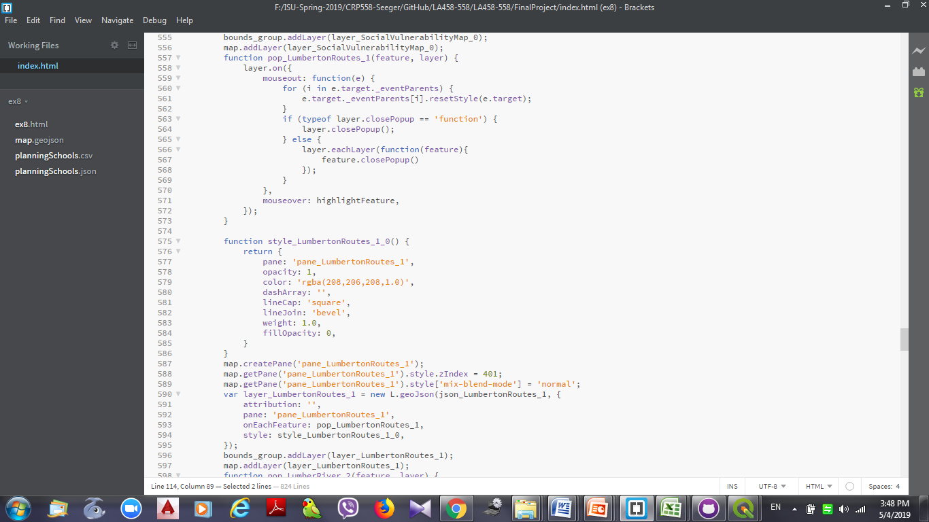
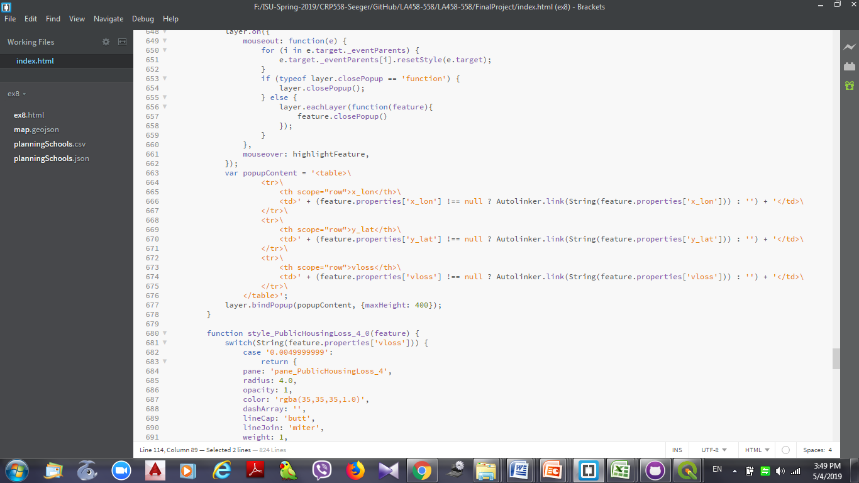

Slide 16
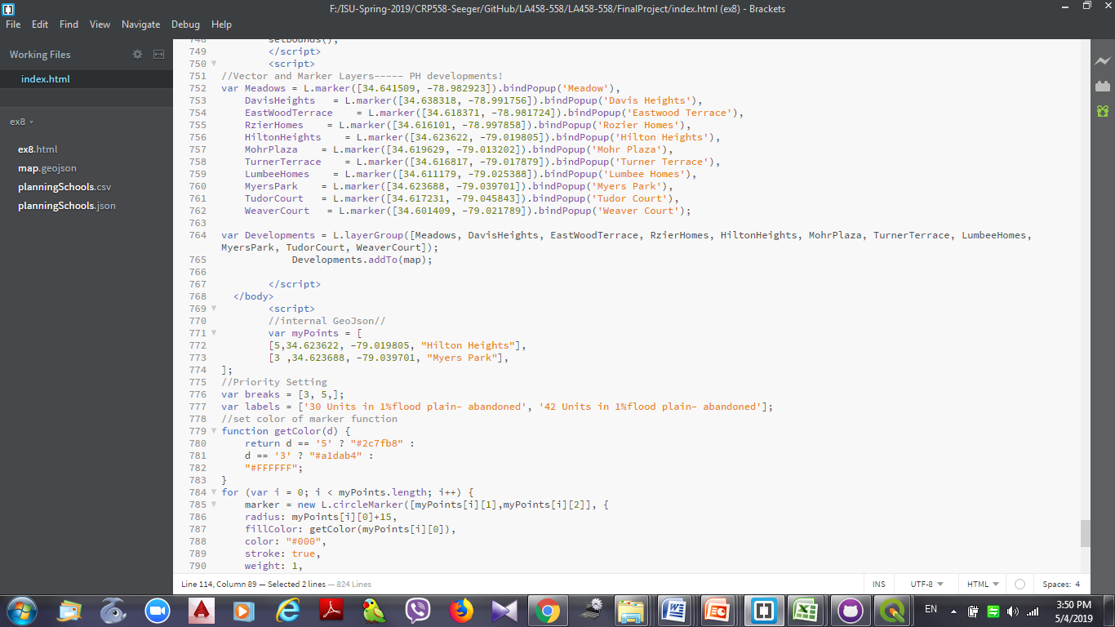
Public Housing Developments Location
Using vector and markers
Using array

Slide 17
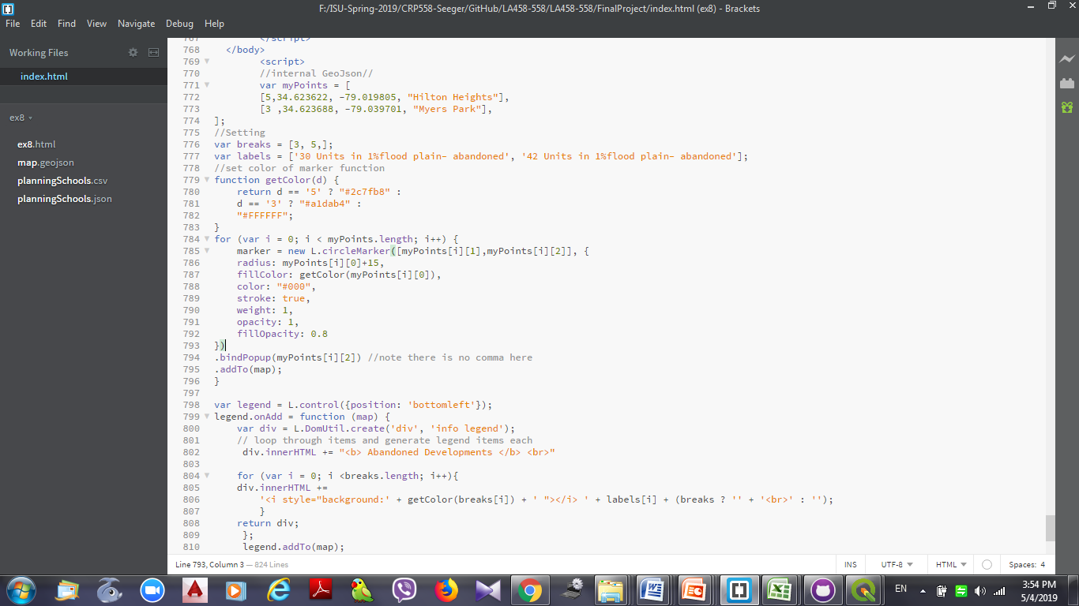
Abandoned Public Housing Developments
Using Internal Geojson
Adding legend

Slide 18
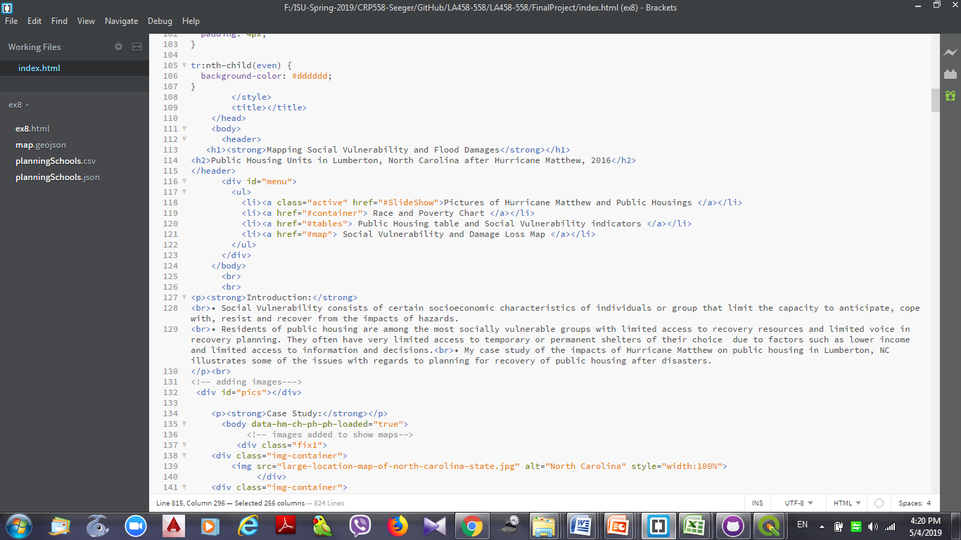
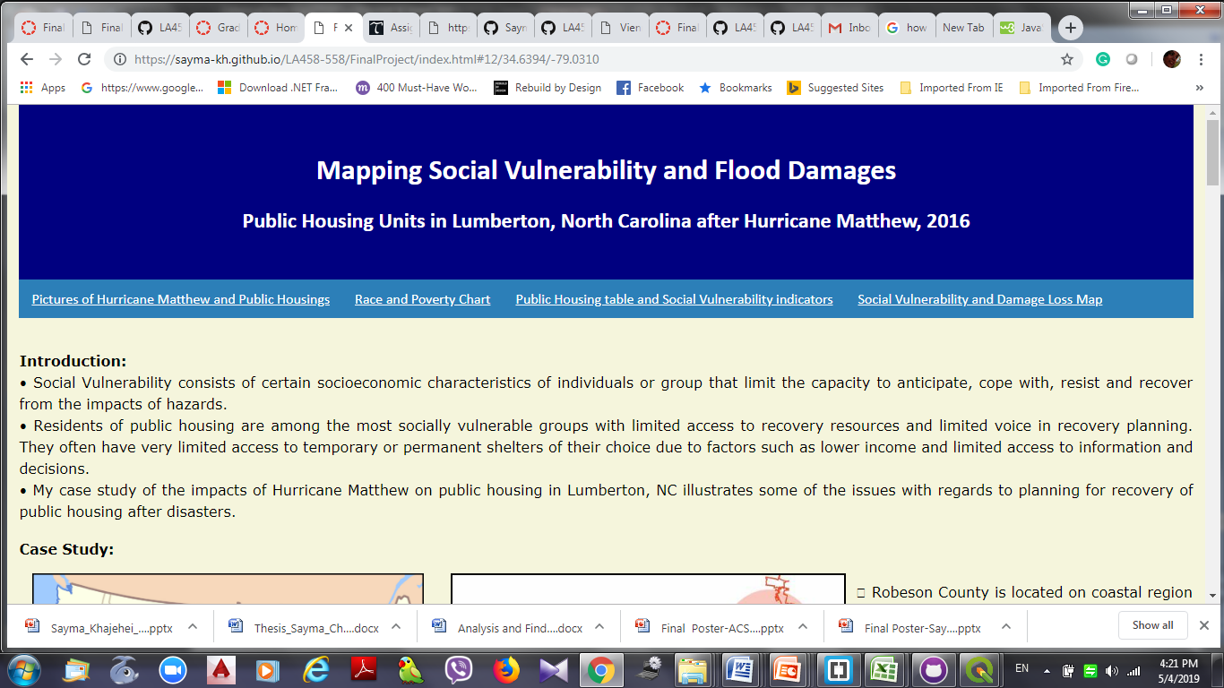
Conclusion
Using QGIS, web mapping, and html coding I attempted to present my project.
I used some links at the top of my web page to make it easier for a visitor to navigate through the page.

Slide 19
Thank You!

